Slide 1
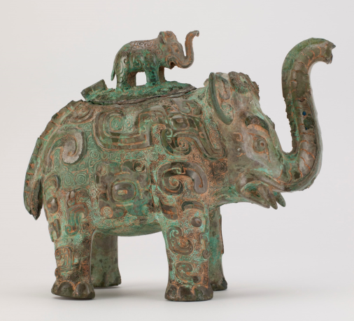
Case Study 3. Determining the casting process of a 3,300-year-old bronze elephant from China
Fig. 997
The question of when lost wax casting was first used in central China has been one of long-standing debate. When this rare sculptural ritual vessel, or huo, was first studied in the 1960’s, it was thought to be cast by such a method. However, more recent excavations of foundry remains contemporaneous to this vessel at Anyang , and the refinement of examination and analytical tools used for the technological study of bronzes, have provided new insights into the casting methods of such vessels in central China during the Shang and Zhou dynasties. The more recent technical study of the elephant-shaped vessel points to clear evidence of quite a different method of production: the piece-mold casting technique, the main method used to create such bronze vessels at that time.
Intro
Context
Questions
Fabrication
Evidence
Corrosion
Repairs
Function
Summary of
findings
Synopsis
Further Questions
Resources

Slide 2
Context
Fig. 997
The Freer acquired this vessel of unknown archaeological provenance in 1936. It would have been used during a burial ceremony and placed in the grave with other burial goods, though it is doubtful that it would have been used as a pouring vessel since the trunk’s spout is too high for liquid to be dispensed without it flowing out from the elephant’s back in the process.
Stylistic evaluation and dating of a sample of the remaining clay core material suggested it was fabricated in China’s Middle Yangtze Valley in the first half of the 11th century BCE, early Western Zhou dynasty. The sculptural elephant form is very rare for Chinese bronze vessels of its time.
Intro
Context
Questions
Fabrication
Evidence
Corrosion
Repairs
Function
Summary of
findings
Synopsis
Further Questions
Resources

Slide 3

Main Questions
Fig. 997
What characteristics point to a piece-mold casting rather then lost wax?
Can one tell how the decorations were created?
What accounts for its condition?
Intro
Context
Questions
Fabrication
Evidence
Corrosion
Repairs
Function
Summary of
findings
Synopsis
Further Questions
Resources

Slide 4
Piece-mold Casting (diagram)
In general, the design of an object cast using the piece-mold method is constrained by the fact that its model is made in loess, a fine-grained refractory soil found throughout Northern China that gives very sharp detail when carved. The mold was made in pieces or sections pieces (hence the terms piece-mold or section-mold casting) designed like a 3-D puzzle to deal with undercuts and allow removal without damage to either the model or the mold pieces.
The vessel and lid would have been cast separately using the piece-mold casting process.
1. A model representing the final form is created, most probably including some of the decorative details.
2. Multiple mold sections are built up around the model.
3. The mold pieces are removed from the model and the interior of mold surface further enhanced by carving.
4. The model is cut back (pared down) to create the core. Small rectangular metal spacers (or “chaplets”) or loess core extensions placed at intervals served to hold the core firmly in place in relation to the outer mold.
5. The mold sections are reassembled around the core. Sprue channels, vents and a pouring reservoir are cut into the piece mold.
6. Molten bronze is poured into the reassembled mold, filling the gap created by the paring down of the model.
7. The cast bronze is broken free of the mold and any imperfections addressed.
diagram
(need to figure out for this and other diagrams how to avoid overload of text/information on one page. Perhaps have slide show of sorts for each step?)
Intro
Context
Questions
Piece-mold Casting
Evidence
Corrosion
Repairs
Function
Summary of
findings
Synopsis
Further Questions
Resources

Slide 5
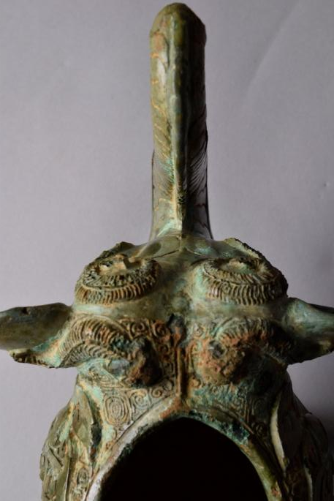
Evidence for piece-molding on the vessel (1)
Metal seam lines invariably developed along mold joins on the exterior surfaces of the cast object. Some were ingeniously incorporated as raised, decorative flanges into the design, others were removed during the finishing process, but often traces can be detected on the surface. One such seam line can be recognized running along the top of the elephant’s trunk and continuing as a raised linear feature between the elephant’s forehead and the rim of the vessel opening.
Visual and microscopic examination allowed us to identify the traces of mold joins across the surfaces of both vessel and lid, and thereby to reverse-engineer the design of the piece-mold segments, which add up to at least a dozen for the main body of the vessel alone. .
Fig. 998
Intro
Context
Questions
Fabrication
Evidence
Corrosion
Repairs
Function
Summary of
findings
Synopsis
Further Questions
Resources

Slide 6
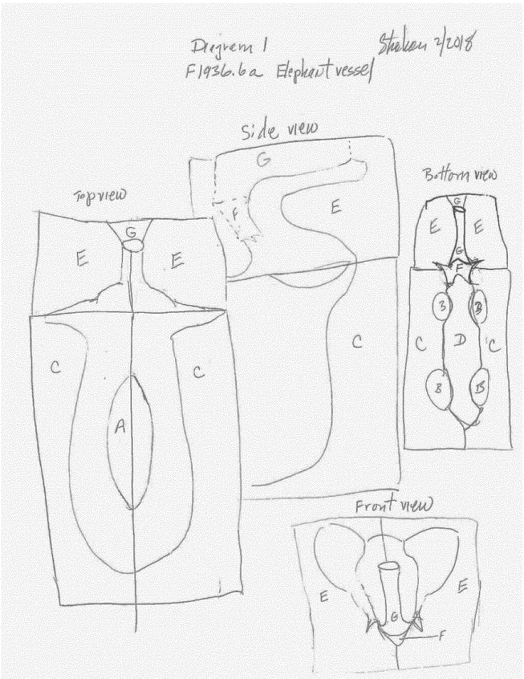
Evidence for piece-molding on the vessel (2)
Fig. 1000
It was determined that the hollow of the vessel’s body was defined by a core inside the belly that reached up to the oval rim of the opening, but did not extend into the legs (A). On the outside, two main mold sections bisected the elephant vertically, running up the tail, along the middle of the back to the back of the ears, and perpendicularly across the top of the head and out over the ears (C).
Fig. 1010
Fig. 999
Intro
Context
Questions
Fabrication
Evidence
Corrosion
Repairs
Function
Summary of
findings
Synopsis
Further Questions
Resources

Slide 7
Evidence for piece-molding on the vessel (3)
Fig. 1002
Detail Fig. 1010
Fig. 1001
A large mold section ran along the belly including the inside of the legs and the lower lip (D).
Two vertical face molds ran down the front of the ears and across the top of the trunk and include the exterior of the tusks (E). A third head mold section included the mouth and tusks (F). A further mold piece formed the front of the trunk (G).
Fig. 1003
Detail Fig. 1010
Intro
Context
Questions
Fabrication
Evidence
Corrosion
Repairs
Function
Summary of
findings
Synopsis
Further Questions
Resources

Slide 8
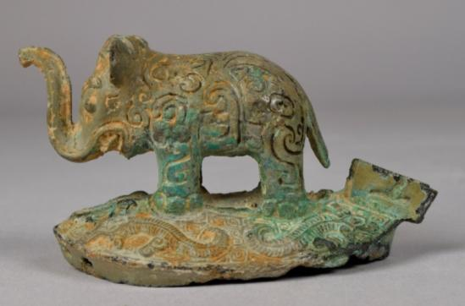
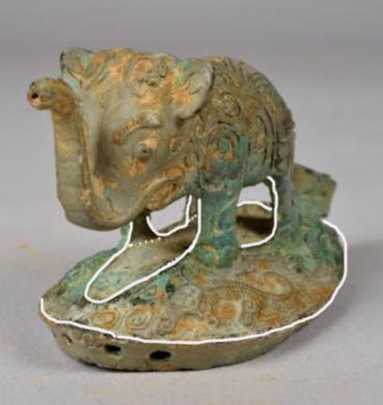
Evidence of piece-molding on the lid
Fig. 1005
Fig. 1004
Fig. 1006
For the lid, two main mold sections (H) were used for either side of the body including the ear, trunk, tail and ridge down the tail (H). A core filled the space inside the legs and under the tail and trunk (K) . Another core (I) filled the underside of the lid using core extensions to secure its attachment to the bottom mold section (J). The holes in the cast rim locate the extensions’ positions.
Fig. 1011
Intro
Context
Questions
Fabrication
Evidence
Corrosion
Repairs
Function
Summary of
findings
Synopsis
Further Questions
Resources

Slide 9
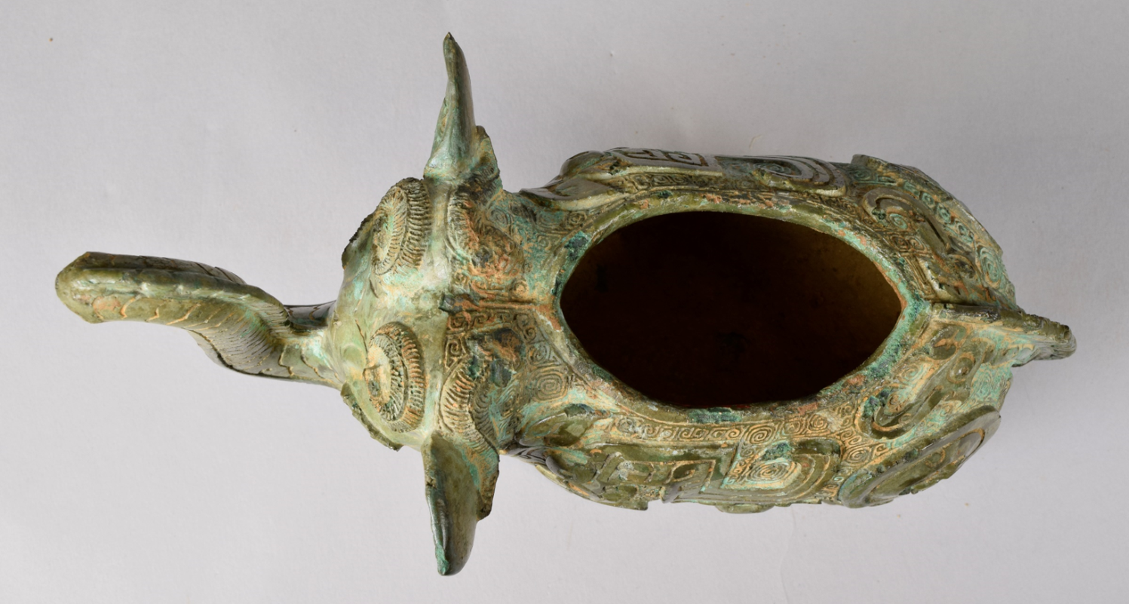
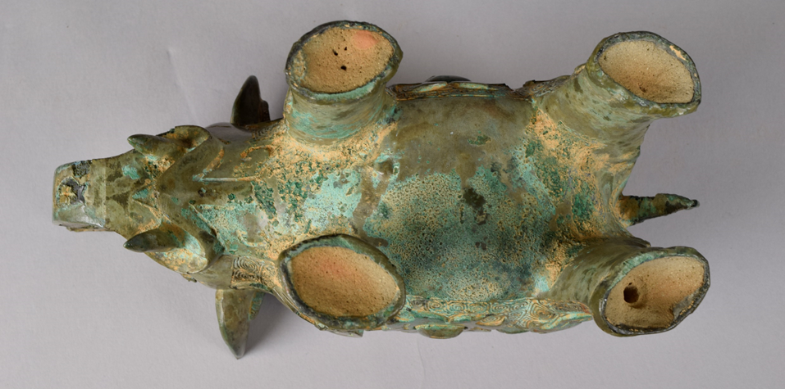
Evidence of core material
Fig. 1000
Currently, there is soil in the interior of the elephant vessel’s belly, but it was originally emptied of its loess core to allow it to function as a vessel.
The legs retain their core material as is often the case with elements like handles and feet in vessels that do not need to be emptied out for functional reasons.
A core sample was drilled from the proper rear right leg to date the vessel using thermoluminescence analysis (link to Vol. 2, ch. 7.1). It placed it in the first half of the 11th century BCE.
Fig. 1001
Intro
Context
Questions
Fabrication
Evidence
Corrosion
Repairs
Function
Summary of
findings
Synopsis
Further Questions
Resources

Slide 10
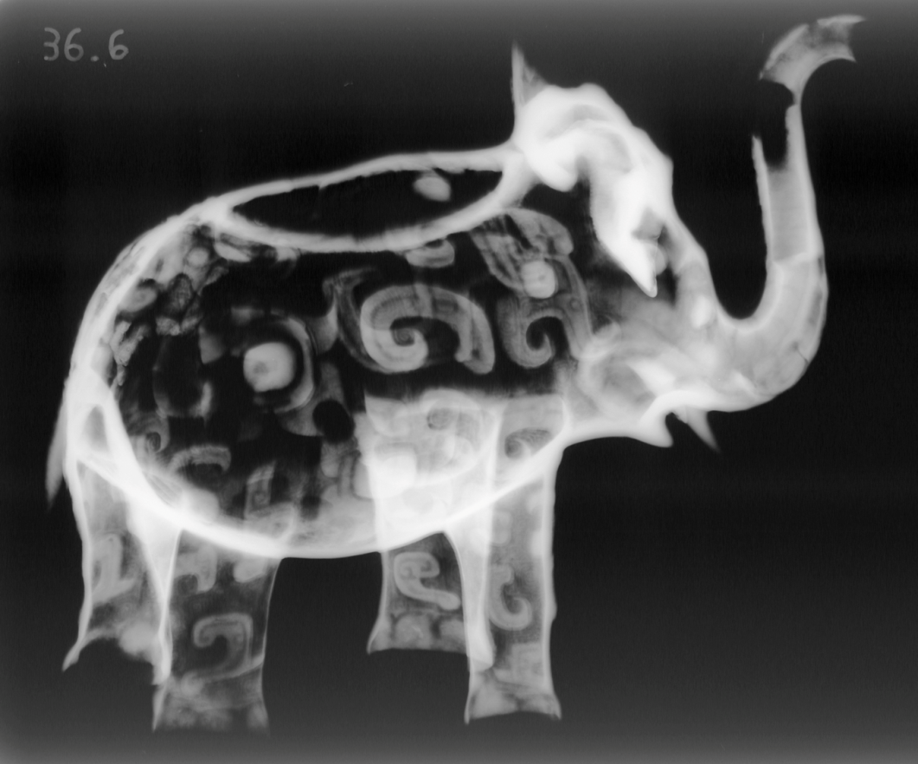
Radiographic evidence
Fig. 1007
X-radiography shows that the walls of the vessel are relatively thin and even. The more x-ray-opaque or whiter features like the decorative elements, indicate areas of thicker metal. Compared to the belly and head, the slightly greater density of the legs and trunk is caused by the extant core material. Radiography also confirms that the top of the legs are closed off by the metal wall of the vessel’s body.
Surprisingly, neither radiography nor visual examination revealed any evidence of metal spacers in the vessel, suggesting that it was loess core extensions that anchored the core in position in relation to the mold. One such extension would have connected the core and mold through the opening on the back of the elephant. Another may have been through the trunk. The cores of the legs would have extended out the openings at the bottom to attach to outer mold sections.
Intro
Context
Questions
Fabrication
Evidence
Corrosion
Repairs
Function
Summary of
findings
Synopsis
Further Questions
Resources

Slide 11
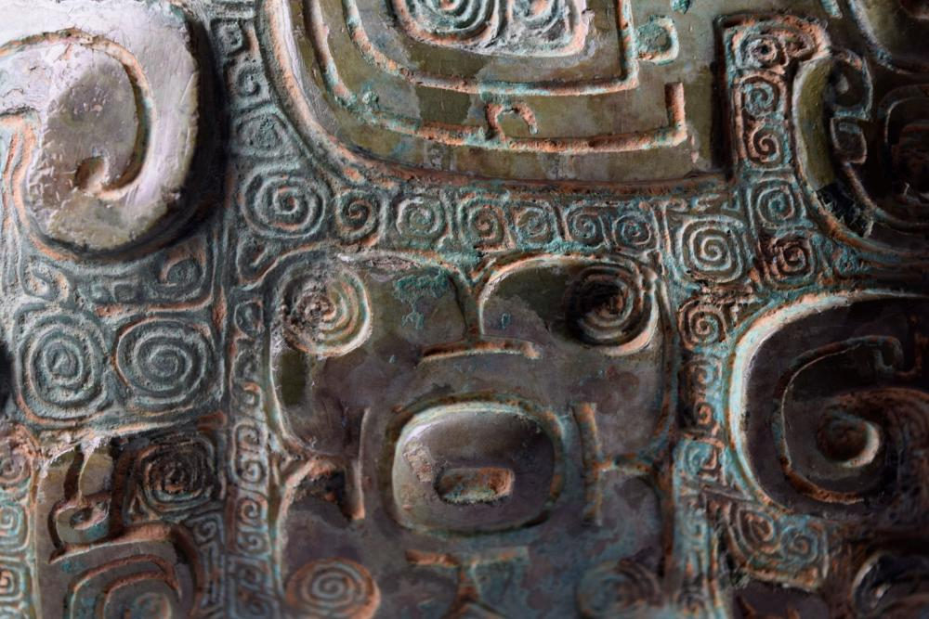
Decorative elements
Fig. 1008
The elaborate incised and relief decoration across the surface of the huo were executed avoiding undercuts to facilitate piece-molding. The fine loess soil used in northern China to make the models and molds was able to capture very sharp, clearly detailed decorative designs. Further refinements would often be added by carving directly into the mold’s surface as is documented in the excavated mold remains from Anyang. In the absence of surviving mold sections from this vessel, it remains unclear whether the huo’s finer cloud and thunder - or “leiwen” – pattern in low relief or the dragons and hooks in high relief were created in the model, the mold, or both. No refinements were made to the design after casting. The leiwen patterns at least show no signs of having been chased in the metal.
Intro
Context
Questions
Fabrication
Evidence
Corrosion
Repairs
Function
Summary of
findings
Synopsis
Further Questions
Resources

Slide 12
Condition
Originally, the vessel’s surface would have been a golden bronze color, perhaps with a pigmented inlay material in the recesses as has been found on other pieces excavated in better condition. Its current mottled, pale gray, green, reddish brown, and very dark, shiny, gray appearance in the larger raised areas, is mostly the result of thousands of years of chemical action during burial in the ground. Despite this corrosion, all the details of the huo’s original design are maintained with little or no disturbance of the surface. What accounts for this given that often corrosion distorts, expands and destroys the surface giving it a rough and bulging, craggy appearance?
X-ray fluorescence analysis (link to Vol. 2, ch. 4.1) identified the corrosion as having a high tin content – presumably a reflection of the alloy composition and burial environment. Tin oxide gives a smooth appearance and is a much smaller molecule than the green copper carbonates. High tin bronzes have relatively good resistance to corrosion in burial conditions, but at the same time are very brittle. That may explain the multiple chips on the higher ridges across the surface . Closer examination showed that the vessel had also been restored post-excavation: many losses had been filled and in-painted to make the surface more aesthetically appealing.
Fig. 997
Fig. 1009
Intro
Context
Questions
Fabrication
Evidence
Corrosion
Repairs
Function
Summary of
findings
Synopsis
Further Questions
Resources

Slide 13

Summary of Findings:
Fig. 1010
The close examination of this object provides irrefutable evidence to that the elephant-shaped vessel was cast by the piece-mold method rather than by the lost wax process, and allowed for a reconstruction of the precise layout of the mold sections. The casting of this rare form shows great technical skill.
The preservation of core material made it possible to date the sculptural vessel more accurately.
The good preservation of the surface detail in spite of the huo’s lengthy burial is no doubt due to the nature of the alloy. There is not much evidence to suggest that the vessel was heavily reworked during restoration.
Intro
Context
Questions
Fabrication
Evidence
Corrosion
Repairs
Function
Summary of
findings
Synopsis
Further Questions
Resources

Slide 14
Synopsis
All of the studies referenced were undertaken by and with conservators using equipment at the Department of Conservation and Scientific Research of the Freer Gallery of Art and Arthur M. Sackler Gallery of Art in the Smithsonian Institution in Washington, D.C.
An individual object examination is part of the day-to-day work of the department and no additional costs were incurred.
Photography and X-radiography: five hours.
Spectrographic analysis: eight hours.
Sampling for Thermoluminescent testing: three hours.
Microscopic examination: three hours.
The interpretation of results: four hours.
Intro
Context
Questions
Fabrication
Evidence
Corrosion
Repairs
Function
Summary of
findings
Synopsis
Further Questions
Resources

Slide 15
Further Questions
How much was the surface reworked after casting?
Can Industrial CT scanning provide clearer images of the intersection of the tops of the elephant’s legs with the bottom of its body cavity?
If there were residues of ritual offerings on the interior of the belly, could analyses determine what the vessel contained?
Can technical comparisons to other ancient bronze elephants recently excavated in China and with provenanced sights provide further information about the Freer elephant?
Intro
Context
Questions
Fabrication
Evidence
Corrosion
Repairs
Function
Summary of
findings
Synopsis
Further Questions
Resources

Slide 16
Further Resources
Gettens, Rutherford J. The Freer Chinese Bronzes, Volume II, Technical Studies, Freer Gallery of Art, Oriental Studies, No. 7, Smithsonian Institution, Washington, 1969.
Pope, John Alexander, Rutherford J. Gettens, James Cahill, Noel Barnard. The Freer Chinese Bronzes, Volume I, Catalogue, Freer Gallery of Art, Oriental Studies, No. 7, Smithsonian Institution, Washington, 1969, pp. 228-231.
Bagley, Robert W. "Part 1: Origin and Development of the Shang Bronze-Casting Industry" and Part 2: "Shang Foundry Methods." Shang Ritual Bronzes in the Arthur M. Sackler Collections, The Arthur M. Sackler Foundation, Washington, D.C., Harvard University Press, 1987, pp. 15-140.
Yue Zhanwei. The Shang Bronze Foundry-Site at Xiaomintun in Anyang City Yinxu Xiaomintun Archaeological Team, (http://www.kaogu.cn/uploads/soft/Chinese%20Archaeology/8/The%20Shang%20Bronze%20Foundry-Site%20at%20Xiaomintun%20in%20Anyang%20City.pdf, accessed 6/2/18) The original paper was published in Kaogu 考古 (Archaeology) 2007.1:14–25, written by Yue Zhanwei 岳 占伟, Wang Xuerong 王学荣, He Yuling 何毓灵, Tang Jinqiong 唐锦琼, Niu Shishan 牛世山 and Gu Fei 谷飞. The present summary is prepared by Yue Zhanwei and translated into English by Mo Runxian 莫润先.
Intro
Context
Questions
Fabrication
Evidence
Corrosion
Repairs
Function
Summary of
findings
Synopsis
Further Questions
Resources

